Slide 1
Virtual LAN Concepts

Slide 2
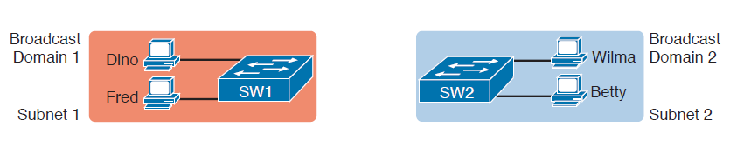
Creating Two Broadcast Domains with Two Physical Switches and No VLANs

Slide 3
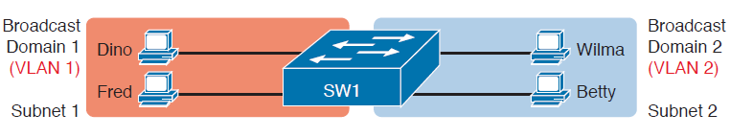
Creating Two Broadcast Domains Using One Switch and VLANs

Slide 4
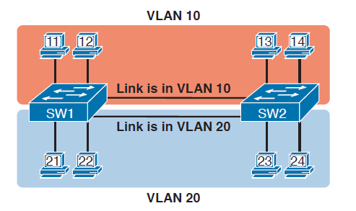
Multiswitch VLAN Without VLAN Trunking

Slide 5
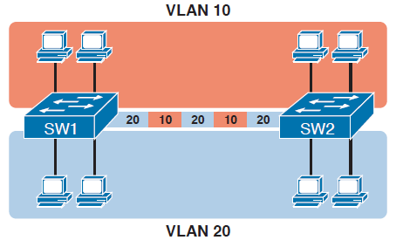
Multiswitch VLAN with Trunking

Slide 6
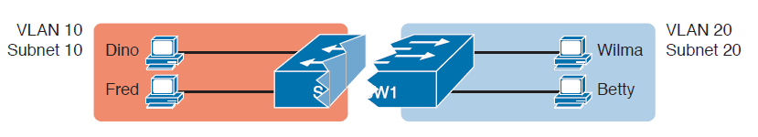
Layer 2 Switch Does Not Route Between the VLANs

Slide 7
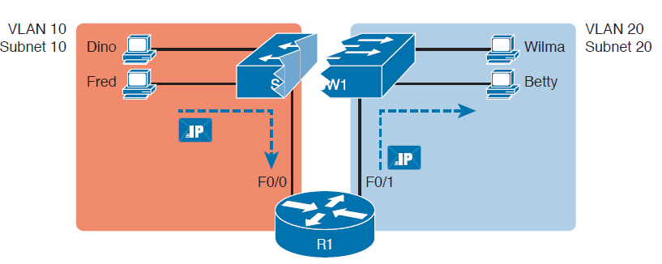
Routing Between Two VLANs on Two Physical Interfaces

Slide 8
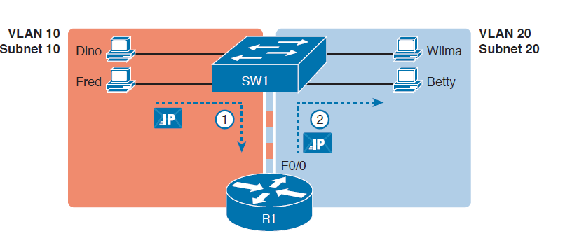
Routing Between Two VLANs Using a Trunk on the Router

Slide 9
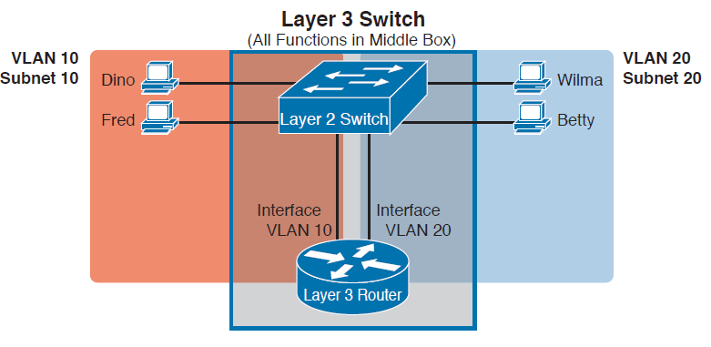
Multilayer Switch: Layer 2 Switching with Layer 3 Routing in One Device

Slide 10
End

